Slide 1
Front End Engineering-I Project
Team Details:
Ruhani Singal 2410991624
Purusharth Aggarwal 2410991603
Faculty Coordinator:
Mr. N. Bharthiraja Kundu
:
Chitkara University Institute of Engineering and Technology,
Chitkara University, Punjab

Slide 2

Table of Contents
Problem Statement
Technical Details
Key Features
Project Highlights
Conclusion
References/Links used

Slide 3
Introduction
Topic: Cafe Management System
1)Welcome to our Café Management System,
2)Your ultimate partner in streamlining café operations and enhancing customer experiences.
3)Designed for both small coffee shops and larger chains, our platform simplifies order processing, inventory management, and customer engagement—all in one user-friendly interface.
4)With real-time analytics and tailored solutions, we empower you to make informed decisions and boost profitability. It will help you create a vibrant café environment where great service and delicious coffee thrive.

Slide 4

Problem Statement
CHALLENGES FACED BY CAFFES :
Manual Order taking and processing
Inventory management difficulties
Customer data tracking limitations
Difficulty in generating reports
Therefore, We are creating a user friendly website using HTML, CSS and JavaScript which will help in easily placing orders online
Its purpose is to manage the caffe management business more efficiently and effectively

Slide 5

Key Features
1) Online Ordering : Customers can place orders directly from the website
2) POS(Point Of Sale) : Efficient order management and payment processing
3) Inventory Management: Real time tracking of Stock Levels
4) Customer Relationship Management: Customer Data Collection and Analysis
5) Reporting And Analytics: Generate detailed reports on sale , revenue, and customer feedback

Slide 6



Technical Details
HTML Components
Header: Logo, navigation links (Home , Orders, Feedback , About us).
Main Content: Product listings, descriptions, videos, .
Footer: Contact information and social media links.
CSS Styling
Layout: Use Flexbox or Grid for responsive design.
Typography: Choose web-safe fonts or integrate Google Fonts.
Colour Scheme: Define a consistent colour palette.
Responsive Design: Media queries for mobile compatibility.
JavaScript Functionality
Dynamic Content Loading: Use AJAX for fetching course data without reloading the page.
Form Validation: Validate user input on forms before submission.
Interactive Elements: Dropdowns, modals for product details or add-ons.

Slide 7

Technical Details
1) The Website is divided into 4 sections
2) The Sections are – Home, About , Orders, Feedback
3) It consists of a header which will easily help to navigate through the whole website and its components
4) The header also includes a search bar made using the search tag to search for the products in an efficient manner
5) It also consists of a “add to cart” option to view the items selected for order and do payments related to it
6) Here we use BUTTON tags to accept order from the customer

Slide 8
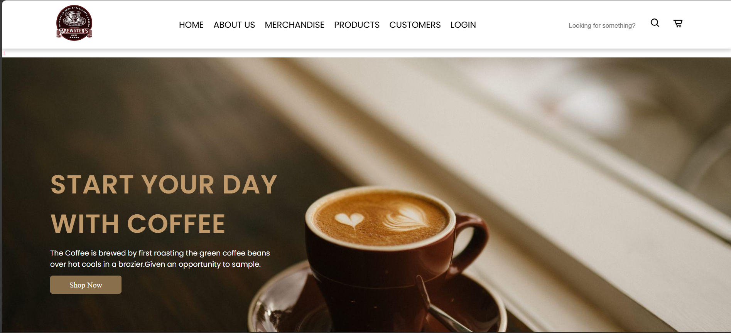
Project Highlights(Home Page)

Slide 9
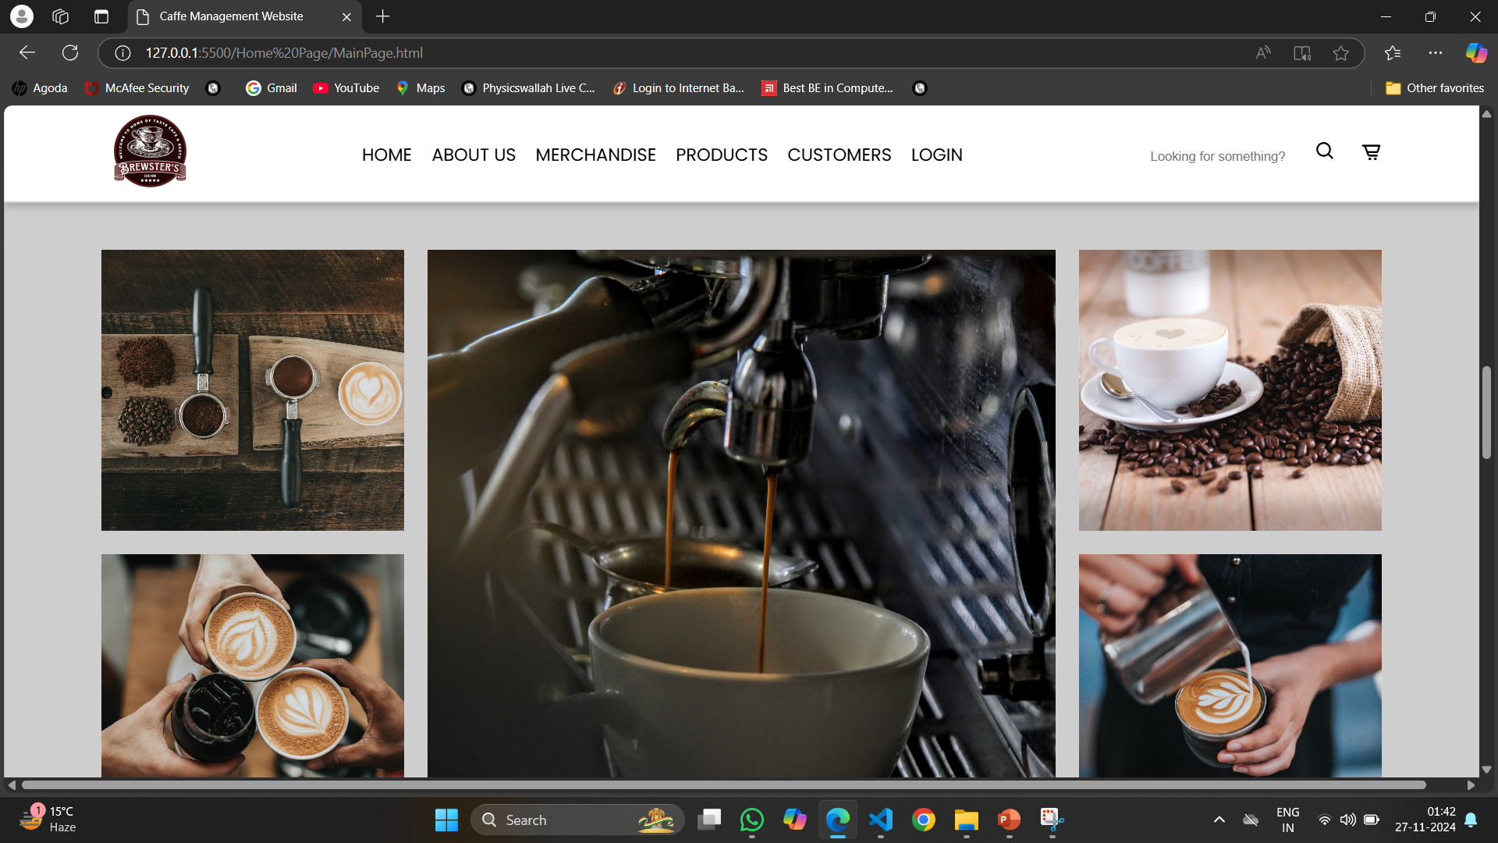
Project Highlights(Home Page)

Slide 10
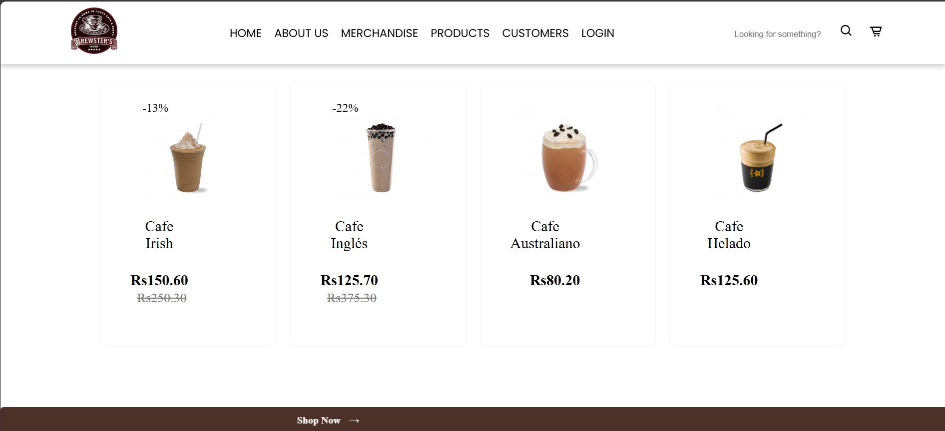
Project Highlights(Home Page)

Slide 11
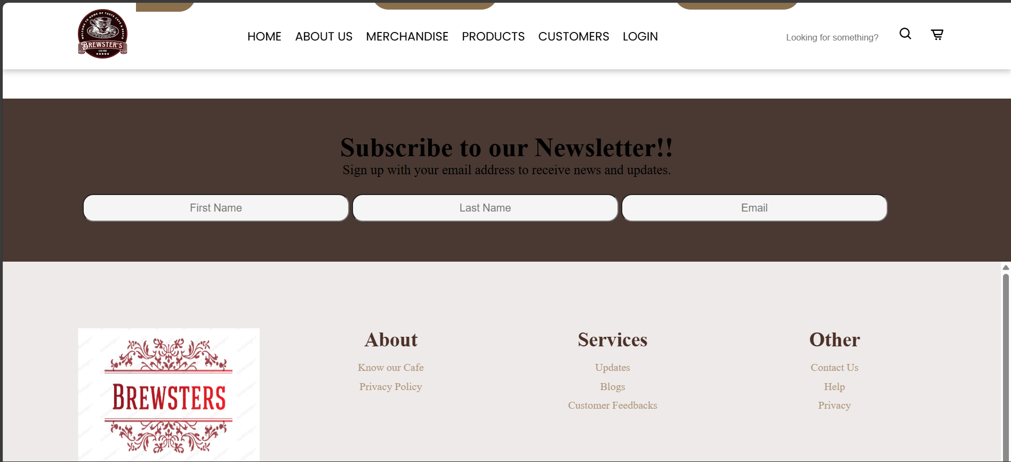
Project Highlights(Footer Section)

Slide 12
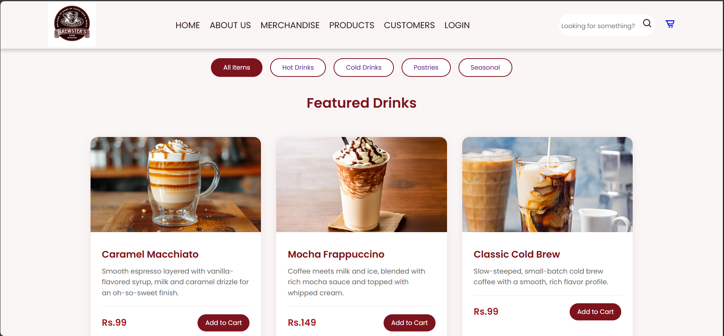
Project Highlights(Main Page)

Slide 13
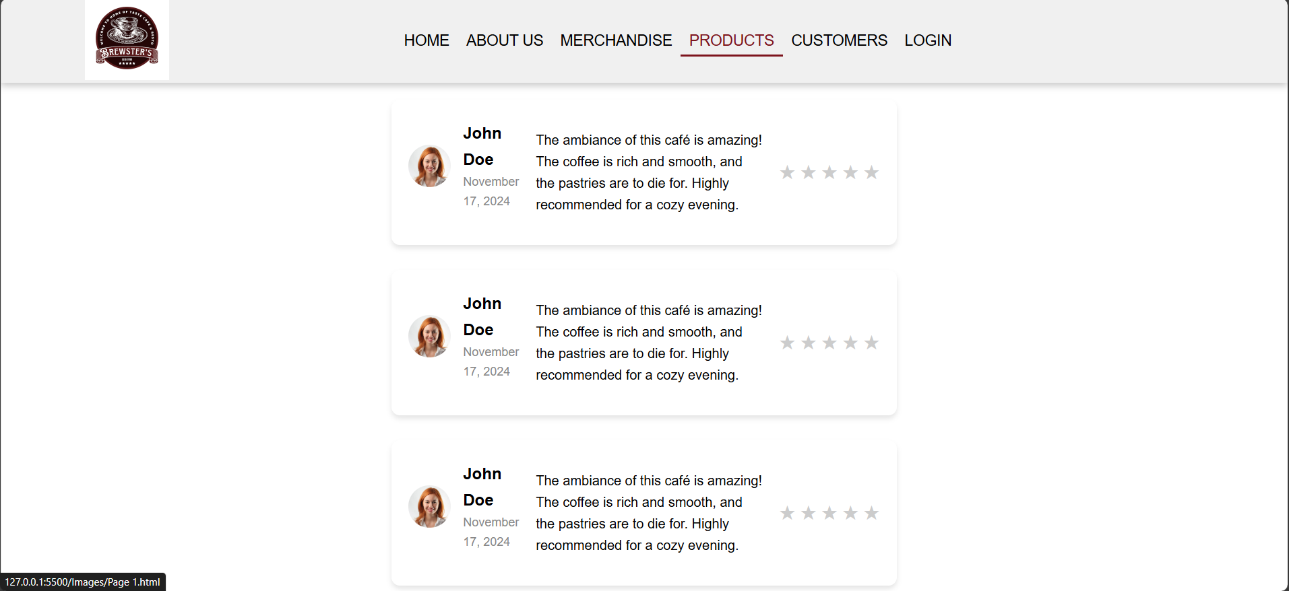
Project Highlights(Review)

Slide 14
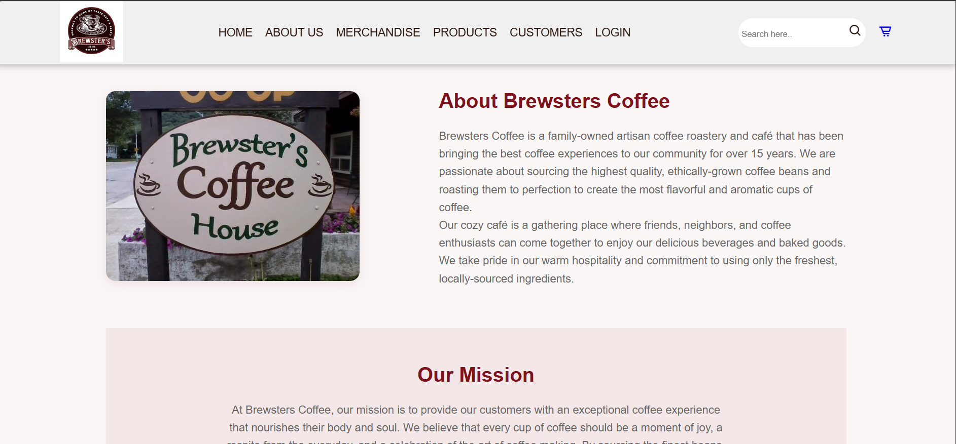
Project Highlights(About Us)

Slide 15
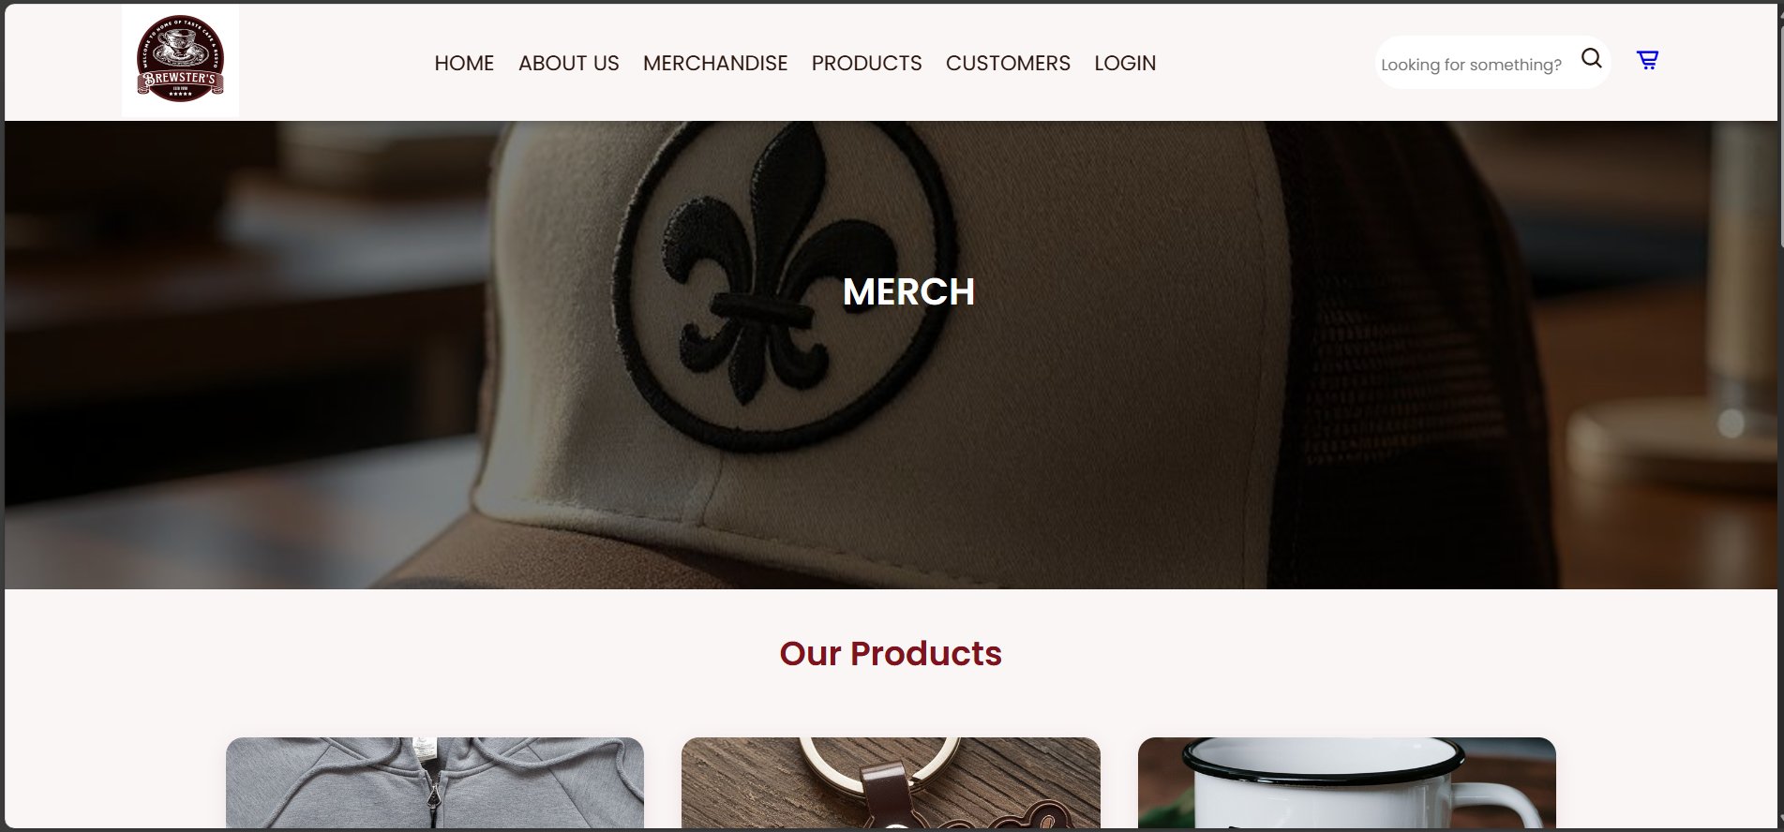
Project Highlights(About Us)

Slide 16
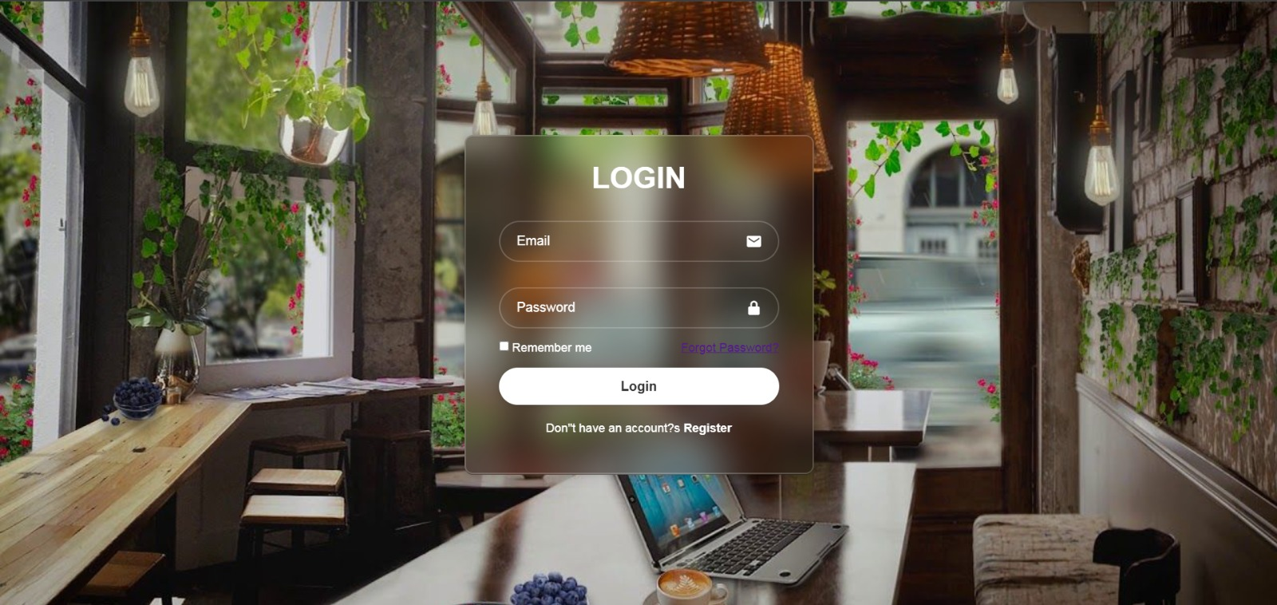
Project Highlights(Login Page)

Slide 17
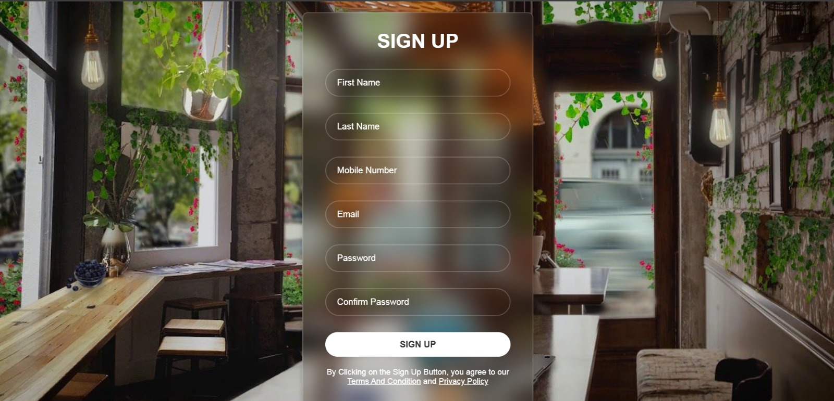
Project Highlights(Sign up Page)

Slide 18

Conclusion
1) This will help the business to stay competitive in a digital driven market as we are using modern methods to display our products online
2) It will also help us to reach to new customers through online methods
3) People can also know about the cafe before their visit so that they could know whether the place suites their desires
4) Customers can also contact us using the Contact Us column in the bottom of the webpage

Slide 19

Bonus Features
1) Quick access to popular items: Highlight top-selling menu items on the ordering interface for easy access, making it faster for the staff to take orders.
2) Customer Birthday Recognition: If customer birthday is on file , offer a small discount or free item on their birthday, adding a personal touch.

Slide 20

References/Links used
https://www.geeksforgeeks.org/
https://www.logoai.com/logo-maker
www.google.com
www.youtube.com
https://developer.com
https://www.w3schools.com/

Slide 21


